Slide 1
Hotel Reservation System
Anthony Argel, Michael Huang, Ej Brand

Slide 2
Problem statement
Travel and tourism is a very large industry, and having accommodations for business people or tourists are very important. Therefore, we made an attempt to create a hotel reservation system (HRS) to replicate the scenario to stimulate the consumer’s perspective and improve user experience on booking a hotel room, while implementing the material we have covered in this CS 146 course.

Slide 3
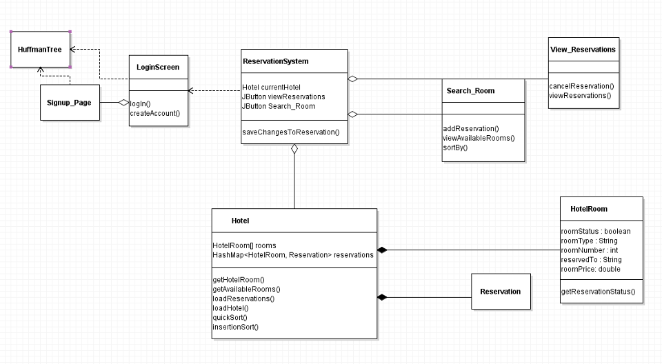
Class Diagram

Slide 4
Test run of our program.

Slide 5
Techniques used
QuickSort (median of 3 implementation)
InsertionSort (for QuickSort small partitions)
Huffman Tree
Huffman encryption
HashMap
Map sorting based on values

Slide 6
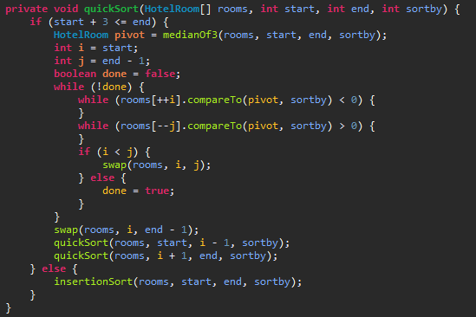
Quicksort

Slide 7
InsertionSort
private void insertionSort(HotelRoom[] rooms, int start, int end, int sortby) {
for (int i = start + 1; i <= end; i++) {
HotelRoom temp = rooms[i];
int j;
for (j = i; j > start && temp.compareTo(rooms[j - 1], sortby) < 0; j--)
rooms[j] = rooms[j - 1];
rooms[j] = temp;
}
}

Slide 8
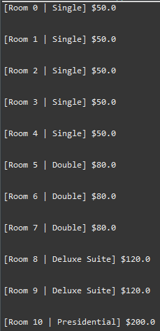
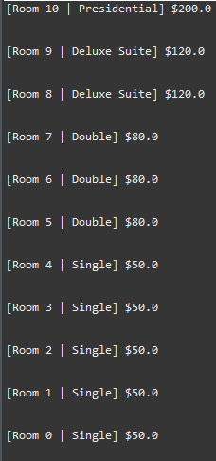
Sort Example
This is sorting by
descending room number.

Slide 9

HuffmanTree, encryption, and Map frequencies

Slide 10
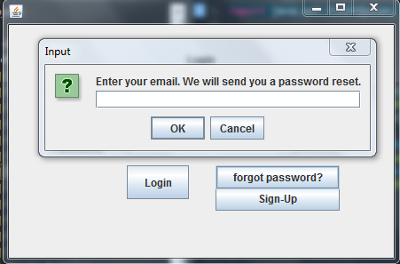
Future enhancements
We originally planned to add an admin menu with features such as retrieving passwords, and managing all hotel rooms and accounts.

Slide 11
Conclusion
Debugging was very time consuming.
Also, java’s default Date class (java.util.Date) is very bad. It is poorly written and is mutable so it was difficult to use. This is why we have our own date class which utilizes the java Calendar class, and has easy to understand and use constructors.

